Slide 1
Lab-6 inverse Laplace transform

Slide 2

Example: Find $L^{−1}\left\{\frac{1}{s}\right\}$
ilt(1/s,s,t);
Output: 1

Slide 3
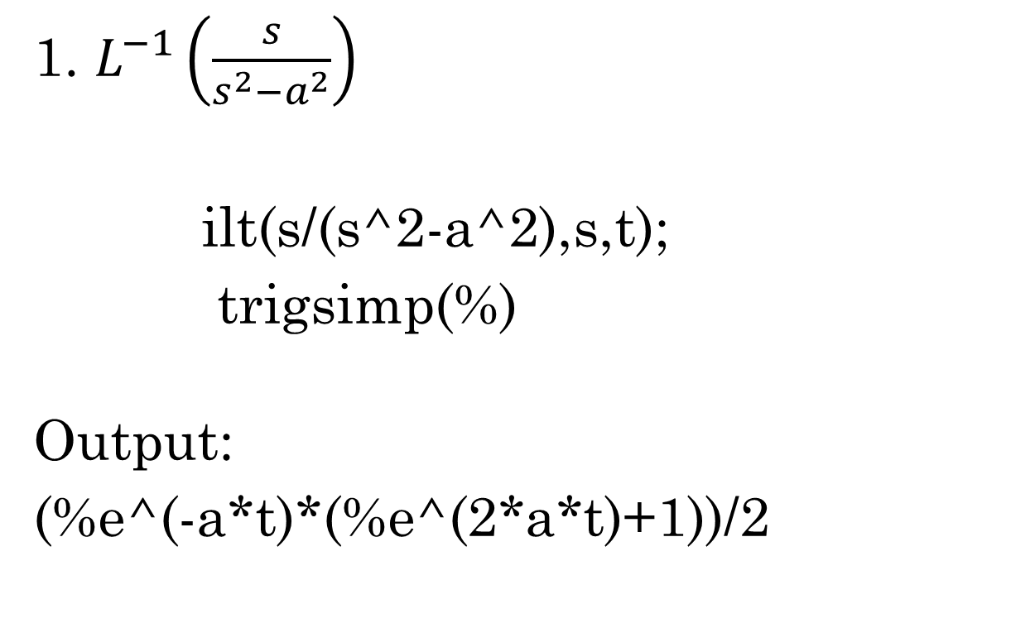
Find the Inverse Laplace Transform of the following functions:
1. $L^{−1}\left(\frac{s}{s^{2}−a^{2}}\right)$
ilt(s/(s^2-a^2),s,t);
trigsimp(%)
Output:
(%e^(-a*t)*(%e^(2*a*t)+1))/2

Slide 4

2) $L^{−1}\left(\frac{s}{s^{2}+a^{2}}\right)$
ilt(s/(s^2+a^2),s,t);
Is a zero or nonzero? non zero
Output: cos at

Slide 5
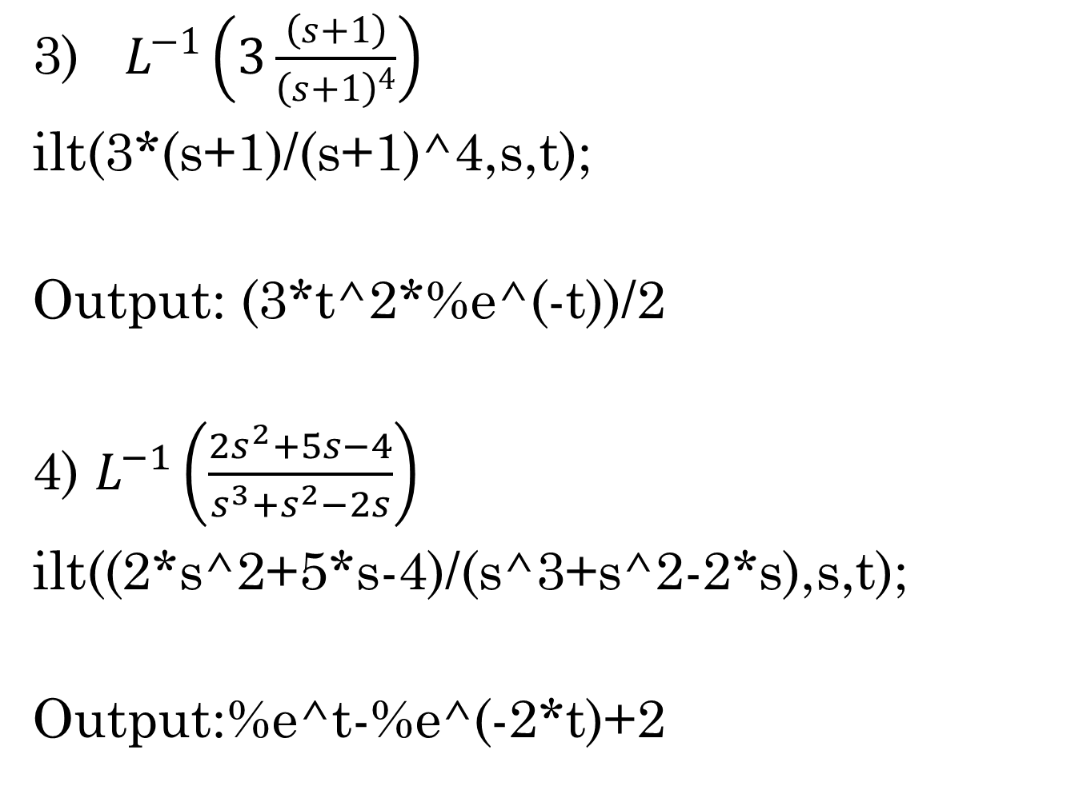
3) $L^{−1}\left(3\frac{\left(s+1\right)}{{\left(s+1\right)}^{4}}\right)$
ilt(3*(s+1)/(s+1)^4,s,t);
Output: (3*t^2*%e^(-t))/2
4) $L^{−1}\left(\frac{2s^{2}+5s−4}{s^{3}+s^{2}−2s}\right)$
ilt((2*s^2+5*s-4)/(s^3+s^2-2*s),s,t);
Output:%e^t-%e^(-2*t)+2

Slide 6
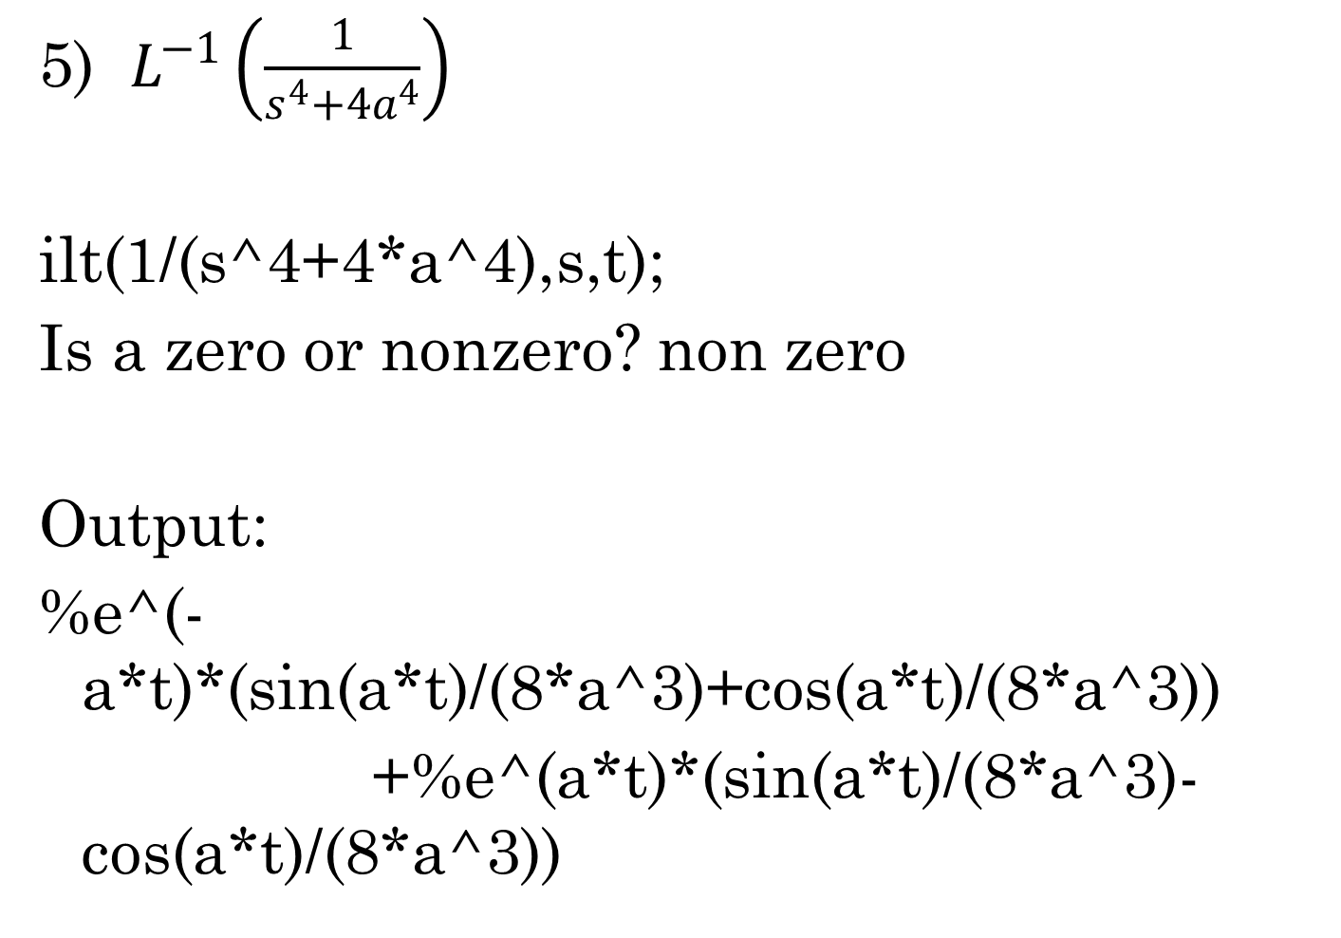
5) $L^{−1}\left(\frac{1}{s^{4}+4a^{4}}\right)$
ilt(1/(s^4+4*a^4),s,t);
Is a zero or nonzero? non zero
Output:
%e^(-a*t)*(sin(a*t)/(8*a^3)+cos(a*t)/(8*a^3))
+%e^(a*t)*(sin(a*t)/(8*a^3)-cos(a*t)/(8*a^3))

Slide 7

6) $L^{−1}\left(\frac{s}{{\left(s^{2}+a^{2}\right)}^{2}}\right)$
ilt((s/(s^2+a^2)^2) ,s,t);
Is a zero or nonzero? non zero
Output:
(t*sin(a*t))/(2*a)

Slide 8
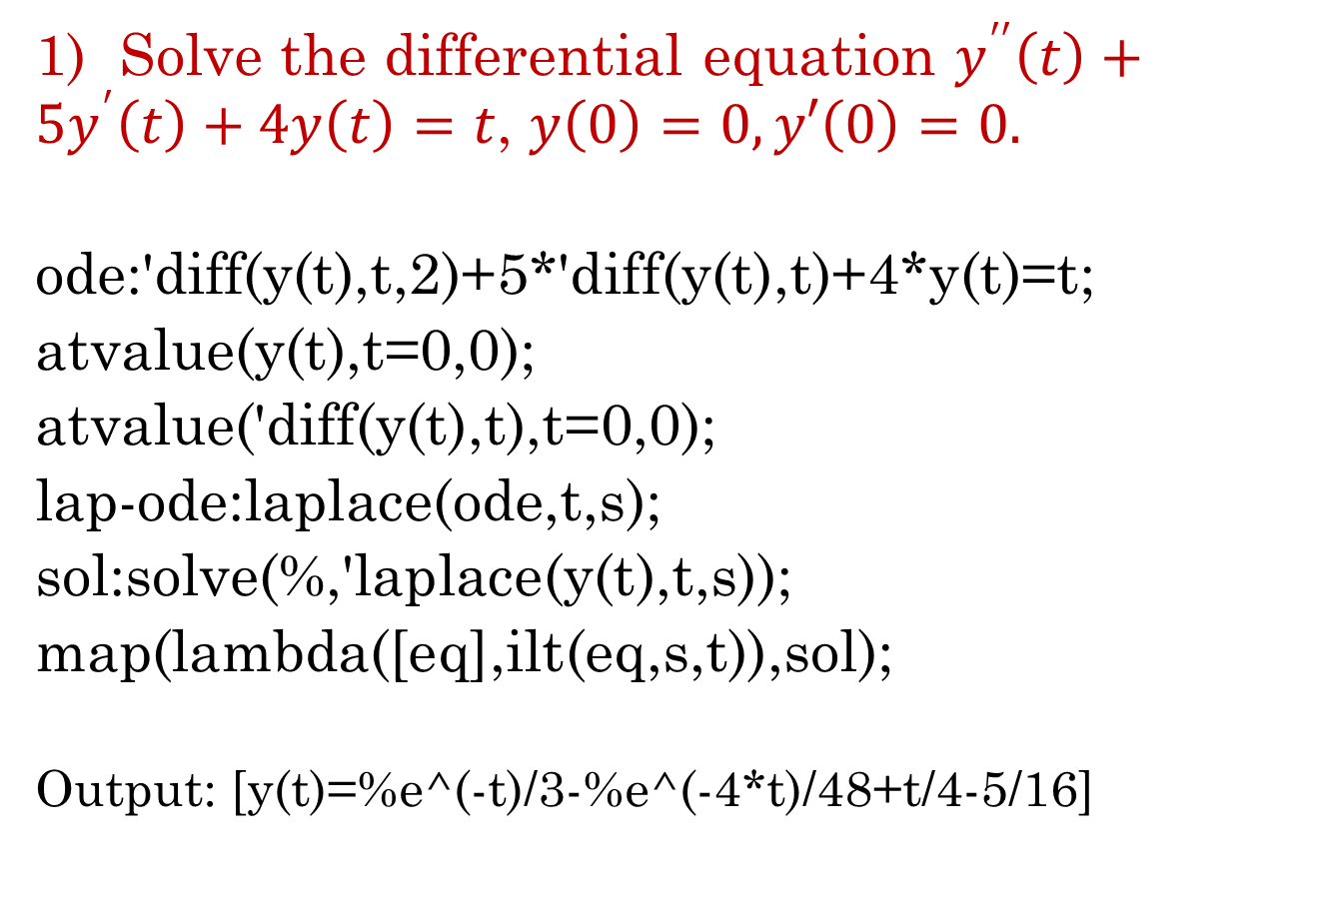
Solution of ode using laplace
1) Solve the differential equation $y^{′′}\left(t\right)+5y^{′}\left(t\right)+4y\left(t\right)=t$, $y\left(0\right)=0,y′\left(0\right)=0.$
ode:'diff(y(t),t,2)+5*'diff(y(t),t)+4*y(t)=t;
atvalue(y(t),t=0,0);
atvalue('diff(y(t),t),t=0,0);
lap-ode:laplace(ode,t,s);
sol:solve(%,'laplace(y(t),t,s));
map(lambda([eq],ilt(eq,s,t)),sol);
Output: [y(t)=%e^(-t)/3-%e^(-4*t)/48+t/4-5/16]

Slide 9
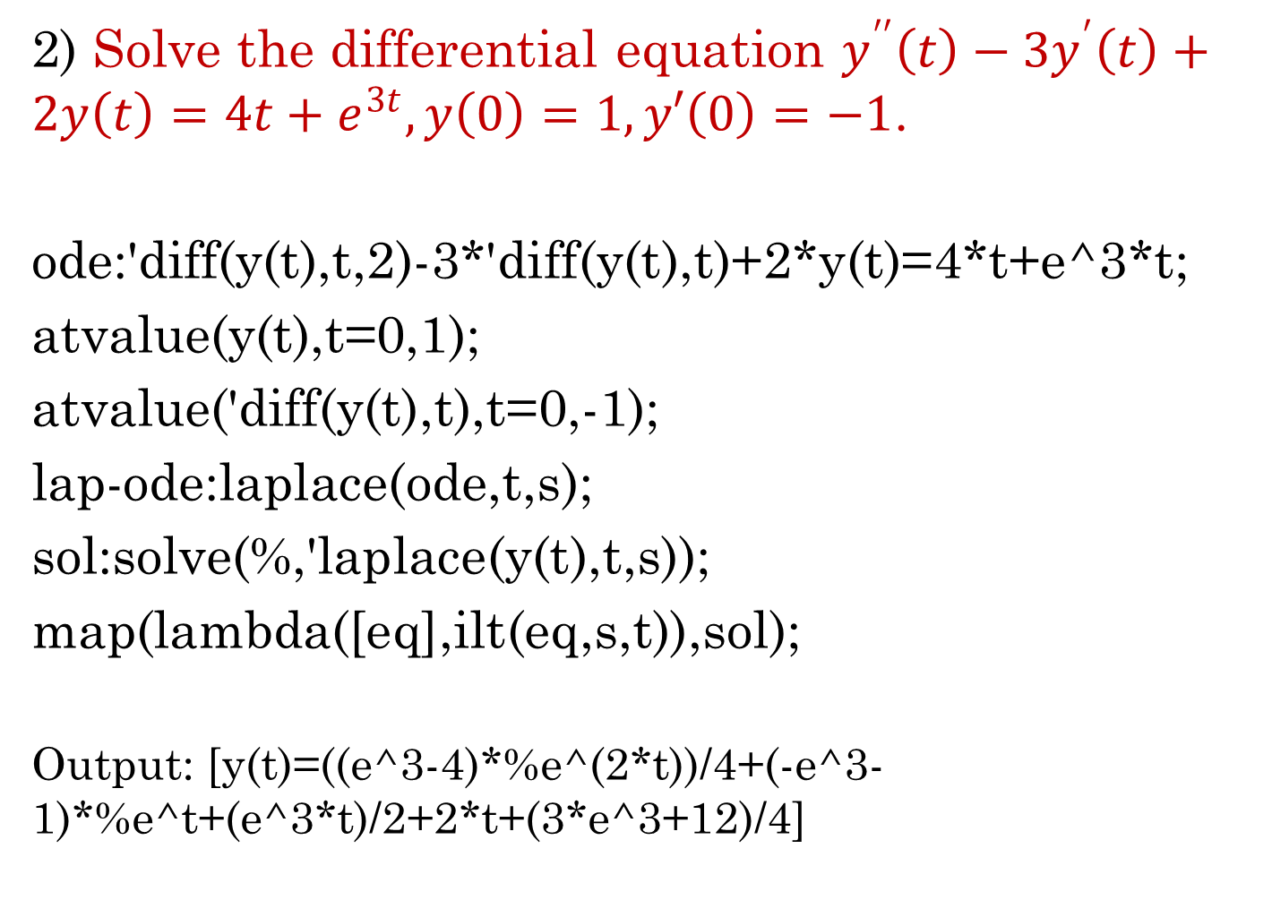
2) Solve the differential equation $y^{′′}\left(t\right)−3y^{′}\left(t\right)+2y\left(t\right)=4t+e^{3t},y\left(0\right)=1,y′\left(0\right)=−1$.
ode:'diff(y(t),t,2)-3*'diff(y(t),t)+2*y(t)=4*t+e^3*t;
atvalue(y(t),t=0,1);
atvalue('diff(y(t),t),t=0,-1);
lap-ode:laplace(ode,t,s);
sol:solve(%,'laplace(y(t),t,s));
map(lambda([eq],ilt(eq,s,t)),sol);
Output: [y(t)=((e^3-4)*%e^(2*t))/4+(-e^3-1)*%e^t+(e^3*t)/2+2*t+(3*e^3+12)/4]

Slide 10
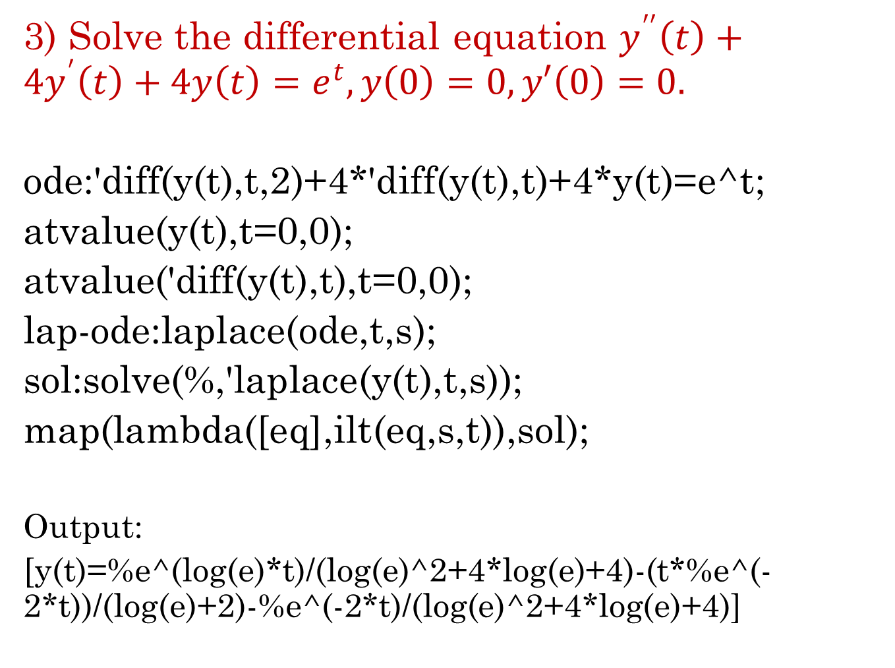
3) Solve the differential equation $y^{′′}\left(t\right)+4y^{′}\left(t\right)+4y\left(t\right)=e^{t},y\left(0\right)=0,y′\left(0\right)=0.$
ode:'diff(y(t),t,2)+4*'diff(y(t),t)+4*y(t)=e^t;
atvalue(y(t),t=0,0);
atvalue('diff(y(t),t),t=0,0);
lap-ode:laplace(ode,t,s);
sol:solve(%,'laplace(y(t),t,s));
map(lambda([eq],ilt(eq,s,t)),sol);
Output:
[y(t)=%e^(log(e)*t)/(log(e)^2+4*log(e)+4)-(t*%e^(-2*t))/(log(e)+2)-%e^(-2*t)/(log(e)^2+4*log(e)+4)]

Slide 11
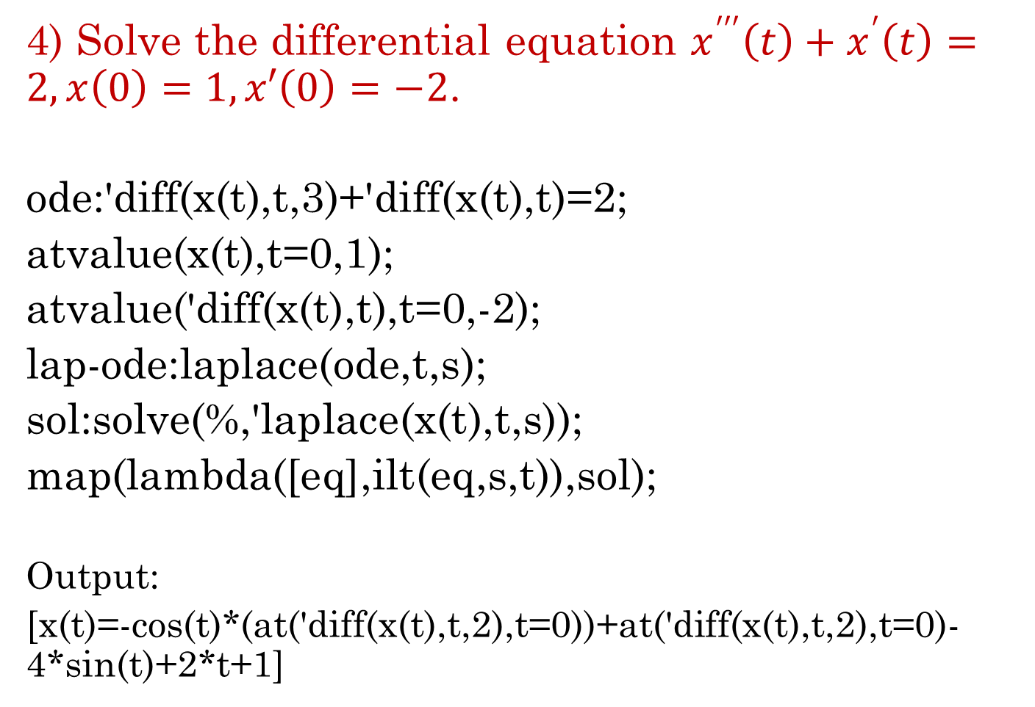
4) Solve the differential equation $x^{′′′}\left(t\right)+x^{′}\left(t\right)=2,x\left(0\right)=1,x′\left(0\right)=−2$.
ode:'diff(x(t),t,3)+'diff(x(t),t)=2;
atvalue(x(t),t=0,1);
atvalue('diff(x(t),t),t=0,-2);
lap-ode:laplace(ode,t,s);
sol:solve(%,'laplace(x(t),t,s));
map(lambda([eq],ilt(eq,s,t)),sol);
Output:
[x(t)=-cos(t)*(at('diff(x(t),t,2),t=0))+at('diff(x(t),t,2),t=0)-4*sin(t)+2*t+1]

Slide 12

Find the inverse laplace of the following function using convolution theorem.
1) $L^{−1}\left(\frac{s}{\left(s^{2}+a^{2}\right)(s^{2}+b^{2})}\right)$
F:s/(s^2+a^2);
G:1/(s^2+b^2);
ilt(F*G,s,t);
ratsimp(%);
Is a zero or nonzero? non zero
Is b zero or nonzero? non zero
Output:
-(cos(b*t)-cos(a*t))/(b^2-a^2)

Slide 13
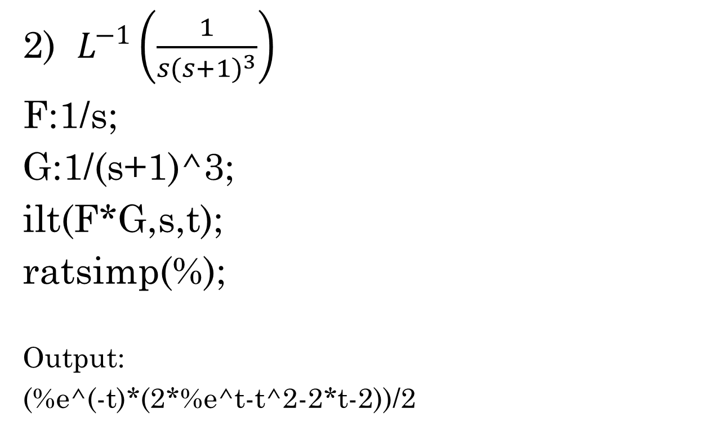
Find the inverse laplace of the following function using convolution theorem.
2) $L^{−1}\left(\frac{1}{s{(s+1)}^{3}}\right)$
F:1/s;
G:1/(s+1)^3;
ilt(F*G,s,t);
ratsimp(%);
Output:
(%e^(-t)*(2*%e^t-t^2-2*t-2))/2

Slide 14

Find the inverse laplace of the following function using convolution theorem.
3) $L^{−1}\left(\frac{s+2}{{\left(s^{2}+4s+5\right)}^{2}}\right)$
F:(s+2)/(s^2+4*s+5);
G:1/(s^2+4*s+5);
ilt(F*G,s,t);
ratsimp(%);
Output:
(t*%e^(-2*t)*sin(t))/2

